Slide 1
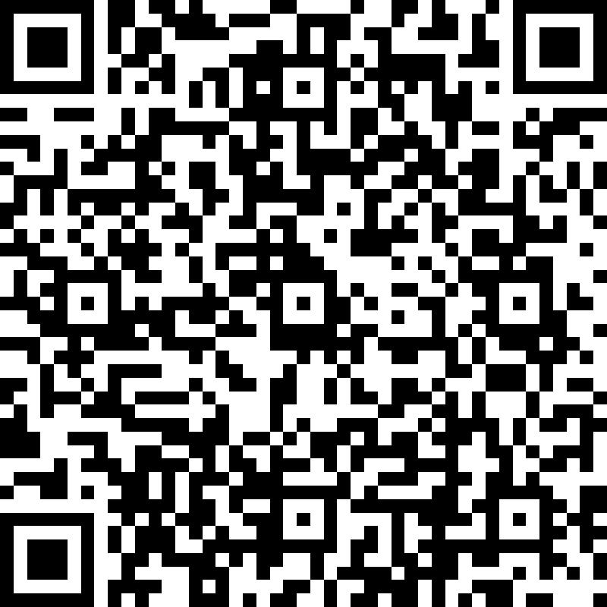
Resources to designers
SHSR video (Moose shared one)
SHSR website that demonstrates its values and, etc.
SHANGHAI SUNRISE
DESIGN THE VOLUNTEERS T-SHIRTS
A COLLABORATIVE COMPETITION
Purpose
Grow with local communities, bringing OI’s Community Collaboration & Engagement activities into real life
Goal
Using your expertise and creativity to design the new style of Shanghai Sunrise T-shirt for its volunteers
Creativity · Spreading Love · With Impact
设计 · 爱 · 传递
As the Designer You Will
Individual Submissions with a maximum 3 entries per person
Must include an unedited Shanghai Sunrise logo and slogan – find in Team’s announcement!
Communicate a positive and healthy education outlook
Use the attached T-shirt template (A4 or A3) to capture the design elements e.g., measurements, colour and positioning
Only printing for the design, no embroidery etc.
Free-style drawing, 3D, CAD, paint, pencil formats etc. are all welcomed
Winning Criteria
“Liked” by Shanghai Sunrise Committee
Winning Award
The prestige of having your design shown at all their Charity events with your signature as a logo
3 T-shirts for you and your family
OI Intranet Posting with your design story
Inspiration Resource www.shanghaisunrise.com
Submit via the QR code or URL by 18th August 2021
Your OI email account
Statement of your design philosophy in either 50 Chinese characters or 35 English words
A PDF file of your design drawing in the name of [SH/DG/QD]_[Designer Name]_[Version No.], e.g., DG_TommyHu_Version1.pdf
Submission Portal

